Slide 1
Project Name:
Dino Gaming Bot

Slide 2
Submitted To:
Dr. M. Firoz Mridha
Associate Professor , Dept. of CSE
Submitted By :
Ashrafuzzaman Shakil Md.Nazirul Isalm | 16173103136 16173103041

Slide 3
Contents
User Components
Packages
Design
Implementation
Output
Limitation
Future Work

Slide 4
User Components
This Method Works on All Devices Having Chrome Installed
Open Google Chrome
Go to “http://www.trex-game.skipser.com/”. There must be network connection in the pc.
Now start playing Automatically

Slide 5
Packages
Here are the list of libraries you’ll be required to install —
Pyautogui
PIL
Time
ImageGrab
ImageOps
NumPy

Slide 6
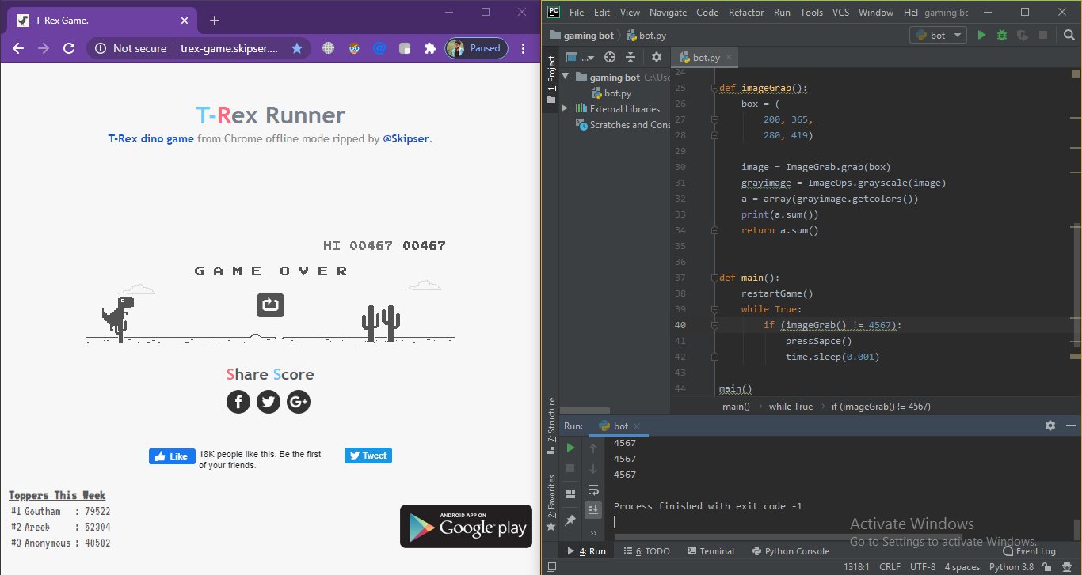
Design

Slide 7
Implementation
1.There are 2 different objects in this game,Dino and replay button if you crash.
class Cordinates(): replayBtn = (341, 386) dinasaur = (370,390)
2.The next step is to actually write a logic for this code.
def imageGrab(): box = ( 190, 365, 280, 419) image = ImageGrab.grab(box) grayimage = ImageOps.grayscale(image) a = array(grayimage.getcolors()) print(a.sum()) return a.sum()

Slide 8
Implementation
3. The next function we write is the jump function, which is basically asks the bot to jump when a tree appears.
def pressSapce():
pyautogui.keyDown('space')
print("jump")
time.sleep(0.18)
pyautogui.keyUp('space')
4.The next function we write is to restart the game. If by chance the bot fails (very low chance), it should automatically restart without human aid.
def restartGame():
pyautogui.click(Cordinates.replayBtn)

Slide 9
Implementation
5. Once done with all our functions, we are ready to write our main function and run it.
def main():
restartGame()
while True:
if (imageGrab() != 5107):
pressSapce()
time.sleep(0.1)
main()

Slide 10
Output

Slide 11
Limitation
Some of the limitation of our game are as follows
Fails to trigger down the dino when that bird comes.
Fails when speed increases
Fails when color changes (color Inversion)

Slide 12
Future Work
In future we will use Q-learning, a technique of RL, where we will try to approximate a special function which drives the action-selection policy for any sequence of environment states

Slide 13
Thank You

